Slide 1
Question: "Are there any black people mentioned in the Bible?"
By Eldon Lingg
9/13/2017

Slide 2
Answer: YES!
We can say with a fair degree of certainty that, yes, the Bible does mention black people, although the Bible does not explicitly identify any person as being black-skinned. Neither does the Bible specifically identify any person as being white-skinned. A person’s skin color is rarely mentioned in the Bible; the color of one’s skin is meaningless to the basic message of the Bible.

Slide 3
Bible’s People
The vast majority of the Bible’s narrative takes place in the Middle East, in and around Israel. Neither “black” nor “white” people are common in these regions. The majority of people in the Bible are Semitic and would have been light to dark brown in complexion. Ultimately, it does not matter what skin color the people in the Bible had.

Slide 4
Moses’ wife, Zipporah
She was black since she was a Cushite (Numbers 12:1)
Num 12:1 And Miriam and Aaron spake against Moses because of the Ethiopian woman whom he had married: for he had married an Ethiopian woman.
Adam Clarke’s Commentary: That Woman, the Cushite, probably meaning Zipporah, who was an Arab born in the land of Midian - was the ostensible cause.
Pulpit Commentary: Hebrew, a Cushite woman. The descendants of Cush were distributed both in Africa (the Ethiopians proper) and in Asia (the southern Arabians, Babylonians, Ninevites, &c.).

Slide 5
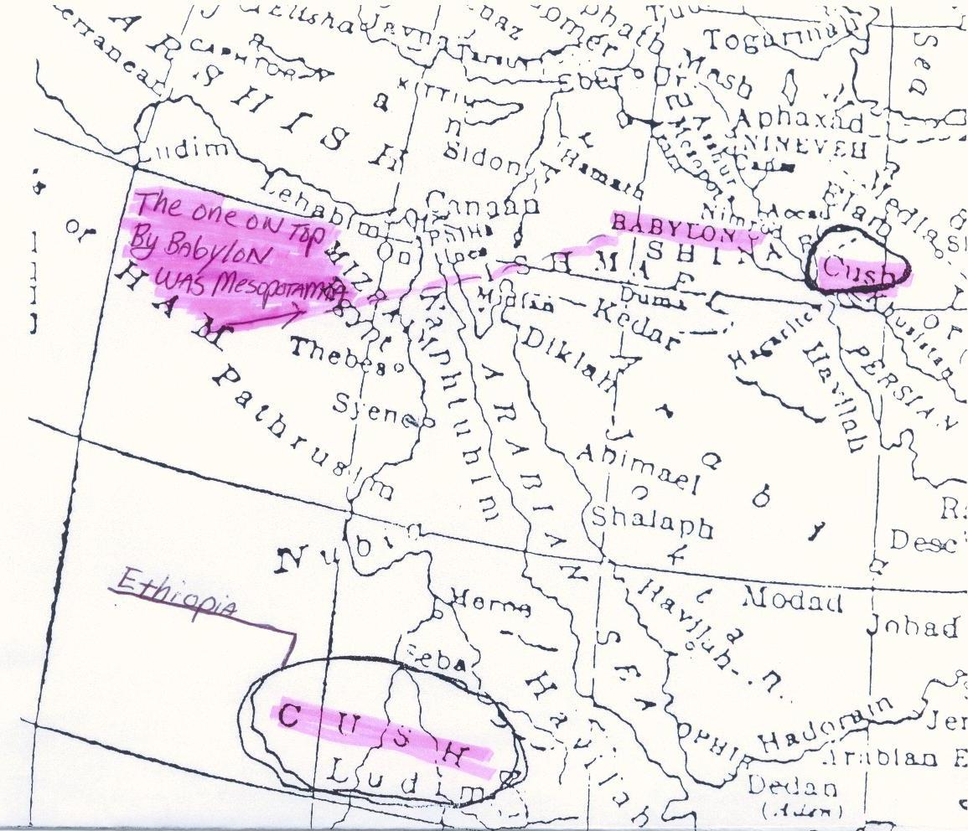
Bible Maps

Slide 6
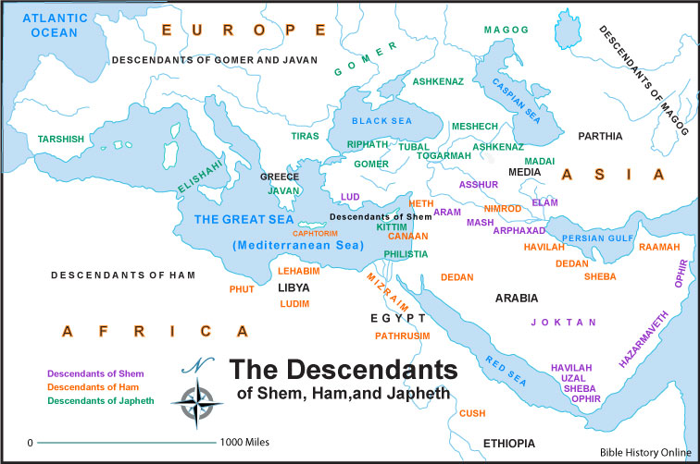

Slide 7
The Shulammite may have been black (Song of Solomon 1:5-6)
Son 1:5 I am black, but comely, O ye daughters of Jerusalem, as the tents of Kedar, as the curtains of Solomon.
Son 1:6 Look not upon me, because I am black, because the sun hath looked upon me: my mother's children were angry with me; they made me the keeper of the vineyards; but mine own vineyard have I not kept.

Slide 8
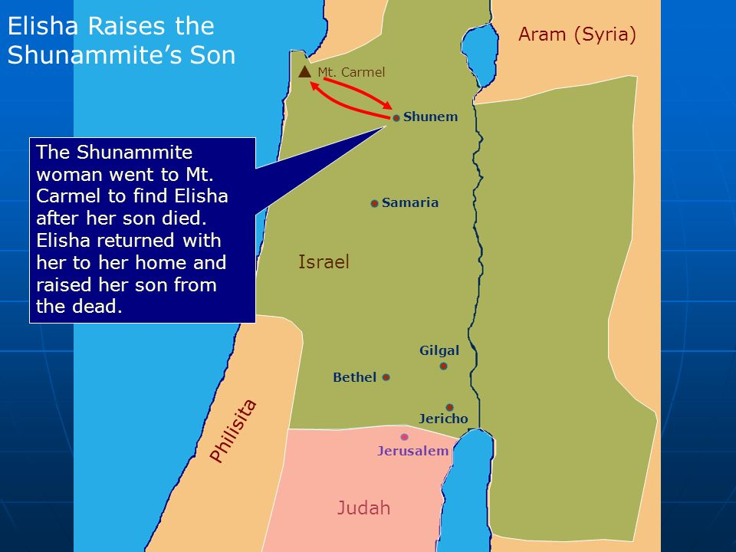
2 Kings 4:1-44

Slide 9
Some propose that Bathsheba (2 Samuel 11:3) was black. Some believe that the Queen of Sheba who visited Solomon (1 Kings 10:1) was black. Simon of Cyrene (Matthew 27:32) may have been black, and also “Simeon called Niger” in Acts 13:1. The Ethiopian eunuch in Acts 8:37 was almost certainly black. Ethiopians are mentioned about 40 times in the Bible, and we can assume that these are references to black people, since Ethiopians are black. The prophet Jeremiah asked, “Can the Ethiopian change his skin?” (Jeremiah 13:23)—the natural assumption is that Jeremiah refers to black skin.

Slide 10
Bathsheba’s Race/National
2Sa_11:3 And David sent and enquired after the woman. And one said, Is not this Bathsheba, the daughter of Eliam, the wife of Uriah the Hittite?
2Sa_23:34 Eliphelet the son of Ahasbai, the son of the Maachathite, Eliam the son of Ahithophel the Gilonite,
The Hittites were the dark descendants of Heth, the second son of Canaan, youngest son of Ham. In the Book of Genesis, they are declared to be one of the 12 Canaanite nations dwelling inside or close to Canaan from the time of Abraham up to Ezra’s era. They lived in the Promised Land to the Israelites. That’s why God commanded the Israelites to eradicate them. But they were not destroyed and still dwell in southern Palestine and around Jerusalem with the Hebrews. The Hittite empire flourished and were shown on the Biblical Timeline chart starting from 2300 BC to about 1100 BC
https://amazingbibletimeline.com/blog/the-hittites/

Slide 11
Job_30:30 My skin is black upon me, and my bones are burned with heat.
Jer_8:21 For the hurt of the daughter of my people am I hurt; I am black; astonishment hath taken hold on me.
Lam_5:10 Our skin was black like an oven because of the terrible famine.

Slide 12
Closing
The color of the skin is not as important to God as the condition of the heart. The gospel is universal good news. Black people, white people, and every shade in between are invited to come to Christ for salvation. By the grace of God we can take our eyes off of the skin and focus on the soul.
Amen!

