Slide 1
Nehemiah
By Eldon Lingg
July 2nd, 2017

Slide 2
How important is prayer?
There are lots of hints in the KJV Bible that bears his name that Nehemiah was a person who lived with an ongoing awareness of the presence of the Lord, and who highly valued the importance of communion with God.

Slide 3
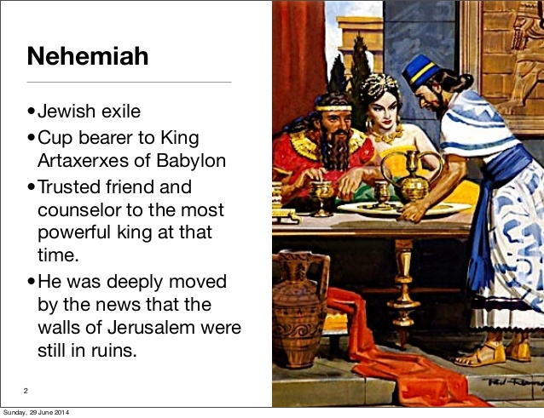

Slide 4
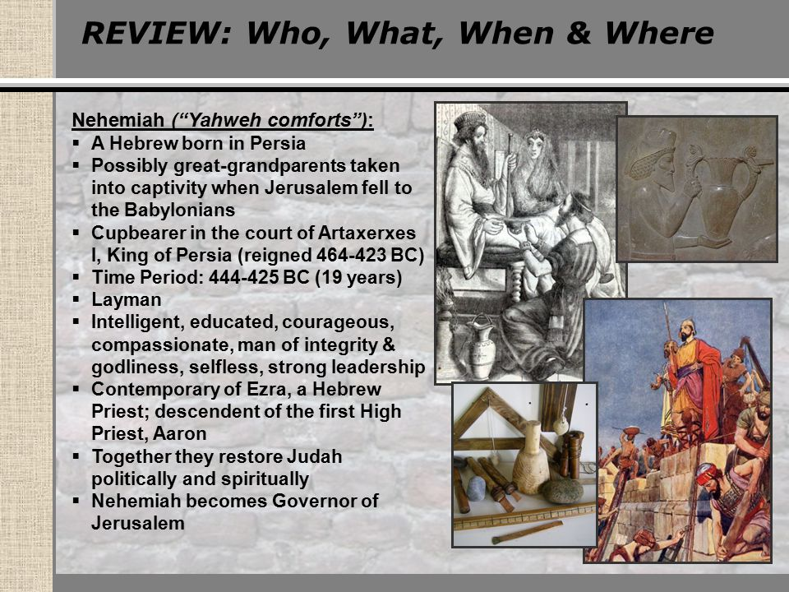

Slide 5
Nehemiah's Prayer
Neh 1:4 And it came to pass, when I heard these words, that I sat down and wept, and mourned certain days, and fasted, and prayed before the God of heaven,
Neh 1:5 And said, I beseech thee, O LORD God of heaven, the great and terrible God, that keepeth covenant and mercy for them that love him and observe his commandments:
Neh 1:6 Let thine ear now be attentive, and thine eyes open, that thou mayest hear the prayer of thy servant, which I pray before thee now, day and night, for the children of Israel thy servants, and confess the sins of the children of Israel, which we have sinned against thee: both I and my father's house have sinned.
Neh 1:7 We have dealt very corruptly against thee, and have not kept the commandments, nor the statutes, nor the judgments, which thou commandedst thy servant Moses.

Slide 6
Neh 1:8 Remember, I beseech thee, the word that thou commandedst thy servant Moses, saying, If ye transgress, I will scatter you abroad among the nations:
Neh 1:9 But if ye turn unto me, and keep my commandments, and do them; though there were of you cast out unto the uttermost part of the heaven, yet will I gather them from thence, and will bring them unto the place that I have chosen to set my name there.
Neh 1:10 Now these are thy servants and thy people, whom thou hast redeemed by thy great power, and by thy strong hand.
Neh 1:11 O Lord, I beseech thee, let now thine ear be attentive to the prayer of thy servant, and to the prayer of thy servants, who desire to fear thy name: and prosper, I pray thee, thy servant this day, and grant him mercy in the sight of this man. For I was the king's cupbearer.

Slide 7
Neh 2:2 Wherefore the king said unto me, Why is thy countenance sad, seeing thou art not sick? this is nothing else but sorrow of heart. Then I was very sore afraid,
Neh 2:3 And said unto the king, Let the king live for ever: why should not my countenance be sad, when the city, the place of my fathers' sepulchres, lieth waste, and the gates thereof are consumed with fire?
Neh 2:4 Then the king said unto me, For what dost thou make request? So I prayed to the God of heaven.
Neh 2:5 And I said unto the king, If it please the king, and if thy servant have found favour in thy sight, that thou wouldest send me unto Judah, unto the city of my fathers' sepulchres, that I may build it.

Slide 8
Neh 4:7 But it came to pass, that when Sanballat, and Tobiah, and the Arabians, and the Ammonites, and the Ashdodites, heard that the walls of Jerusalem were made up, and that the breaches began to be stopped, then they were very wroth,
Neh 4:8 And conspired all of them together to come and to fight against Jerusalem, and to hinder it.
Neh 4:9 Nevertheless we made our prayer unto our God, and set a watch against them day and night, because of them.

Slide 9
Neh 5:9 Also I said, It is not good that ye do: ought ye not to walk in the fear of our God because of the reproach of the heathen our enemies?
Neh 5:10 I likewise, and my brethren, and my servants, might exact of them money and corn: I pray you, let us leave off this usury.
Neh 5:11 Restore, I pray you, to them, even this day, their lands, their vineyards, their oliveyards, and their houses, also the hundredth part of the money, and of the corn, the wine, and the oil, that ye exact of them.
Neh 5:12 Then said they, We will restore them, and will require nothing of them; so will we do as thou sayest. Then I called the priests, and took an oath of them, that they should do according to this promise.
Neh 5:13 Also I shook my lap, and said, So God shake out every man from his house, and from his labour, that performeth not this promise, even thus be he shaken out, and emptied. And all the congregation said, Amen, and praised the LORD. And the people did according to this promise.

Slide 10
Neh 5:19 Think upon me, my God, for good, according to all that I have done for this people.
Neh 13:14 Remember me, O my God, concerning this, and wipe not out my good deeds that I have done for the house of my God, and for the offices thereof.
Neh 13:29 Remember them, O my God, because they have defiled the priesthood, and the covenant of the priesthood, and of the Levites.
Neh 13:30 Thus cleansed I them from all strangers, and appointed the wards of the priests and the Levites, every one in his business;
Neh 13:31 And for the wood offering, at times appointed, and for the firstfruits. Remember me, O my God, for good.

Slide 11
Mar 9:25 When Jesus saw that the people came running together, he rebuked the foul spirit, saying unto him, Thou dumb and deaf spirit, I charge thee, come out of him, and enter no more into him.
Mar 9:26 And the spirit cried, and rent him sore, and came out of him: and he was as one dead; insomuch that many said, He is dead.
Mar 9:27 But Jesus took him by the hand, and lifted him up; and he arose.
Mar 9:28 And when he was come into the house, his disciples asked him privately, Why could not we cast him out?
Mar 9:29 And he said unto them, This kind can come forth by nothing, but by prayer and fasting.

Slide 12
Mat 21:22 And all things, whatsoever ye shall ask in prayer, believing, ye shall receive.
Mat 6:7 But when ye pray, use not vain repetitions, as the heathen do: for they think that they shall be heard for their much speaking.
Luk 21:36 Watch ye therefore, and pray always, that ye may be accounted worthy to escape all these things that shall come to pass, and to stand before the Son of man.

